Slide 1
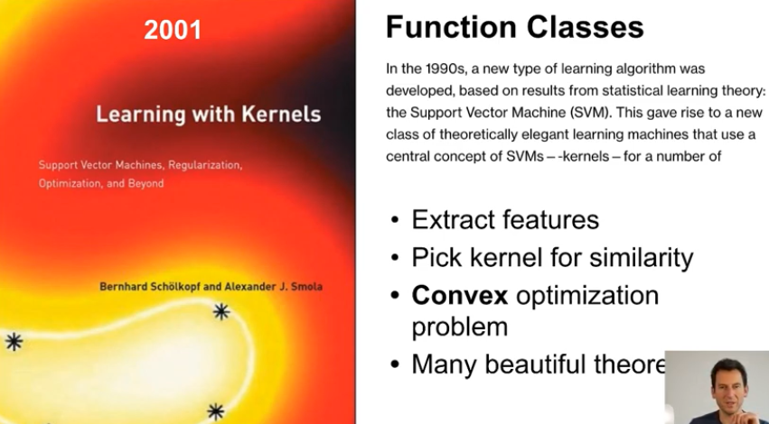
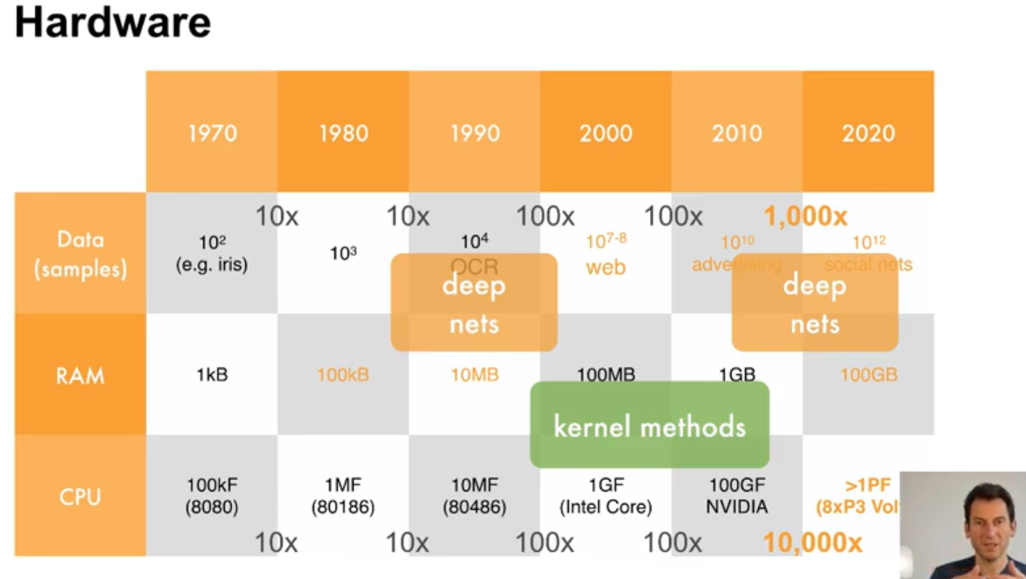
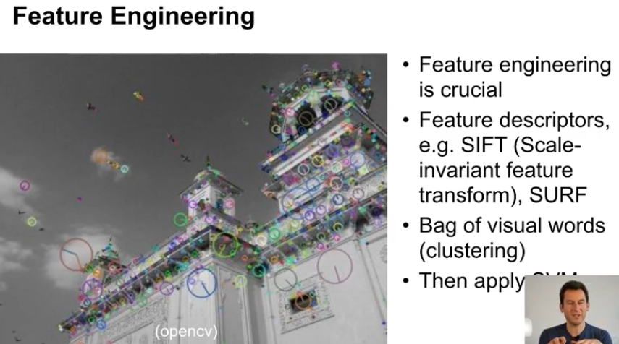
Deep Learning UC Berkeley STAT-157 2019
https://www.youtube.com/playlist?list=PLZSO_6-bSqHQHBCoGaObUljoXAyyqhpFW
Feature engineering was crucial and limited the engineering throughput you can do because for every new problem you had to do additional feature engineering
Breakthrough in compute in 2010 when we switched to massively multicore architectures like GPUs
1990 deep nets : datasets and memory tiny, some compute | 2000 kernel methods : datasets not too big, possible to store non trivial parts of the kernel matrix in memory (grows linearly with the amount of data that you have) | 2010 : huge leap in compute, pratically feasible to switch to non linear, non convex, highly compute intensive settings = deep networks

Slide 2
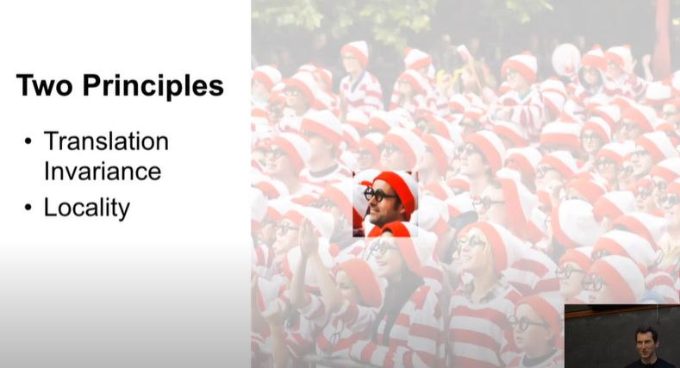
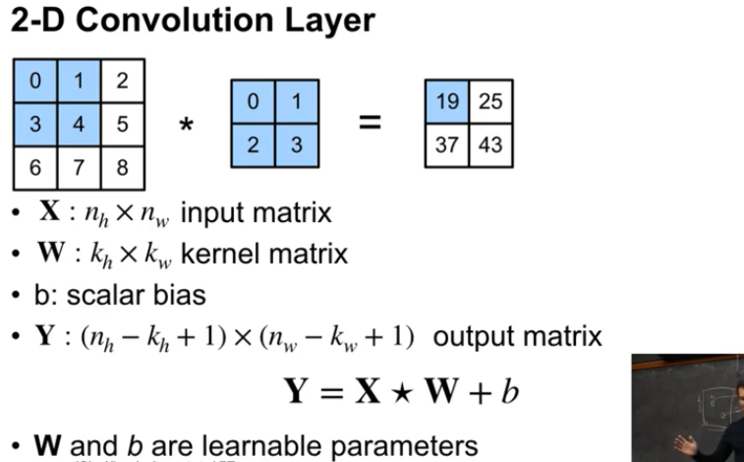
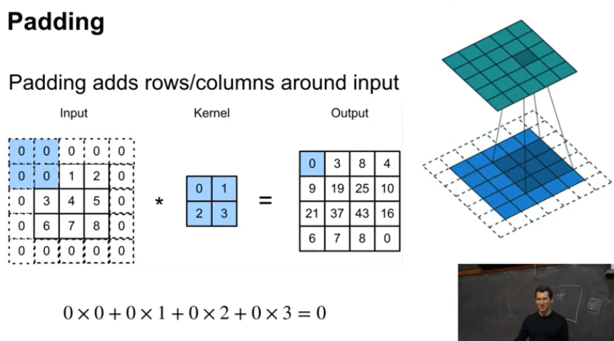
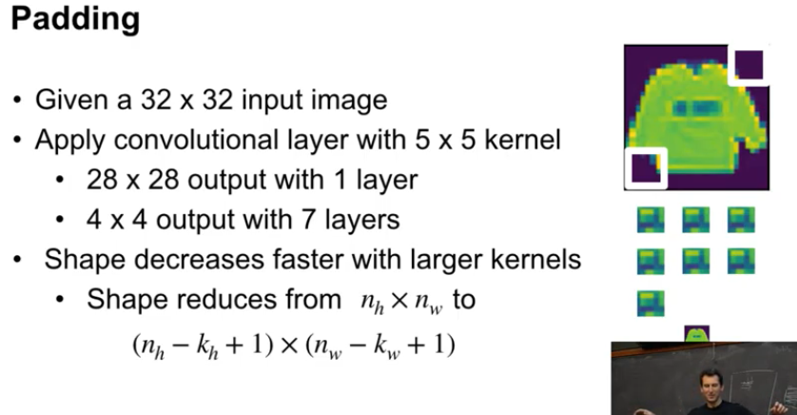
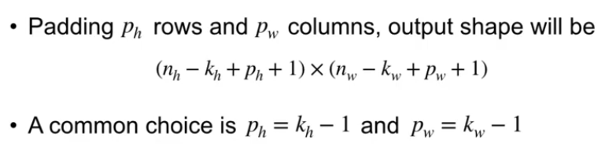

Slide 3
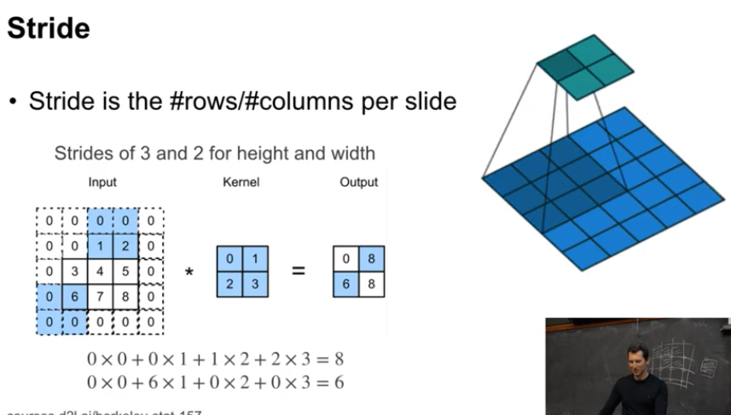
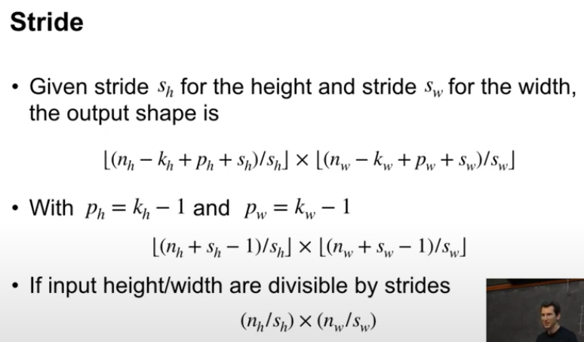
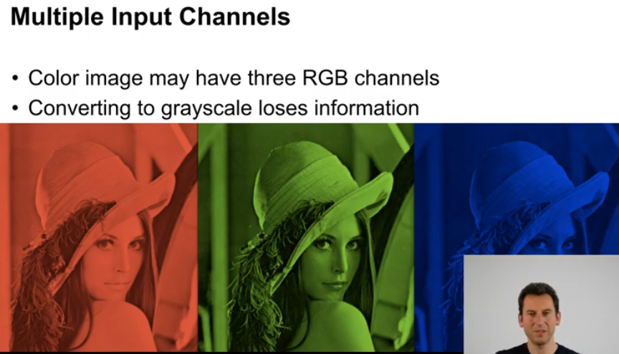
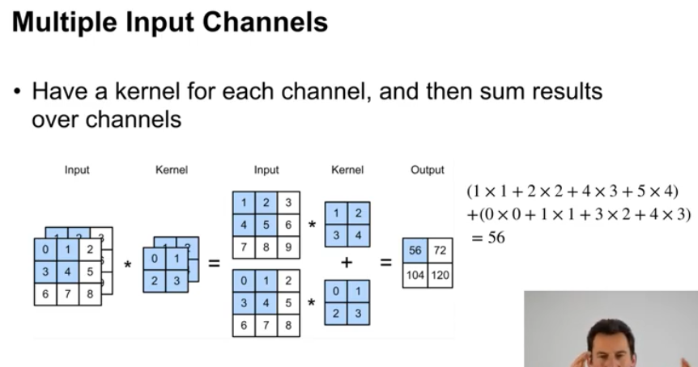

Slide 4
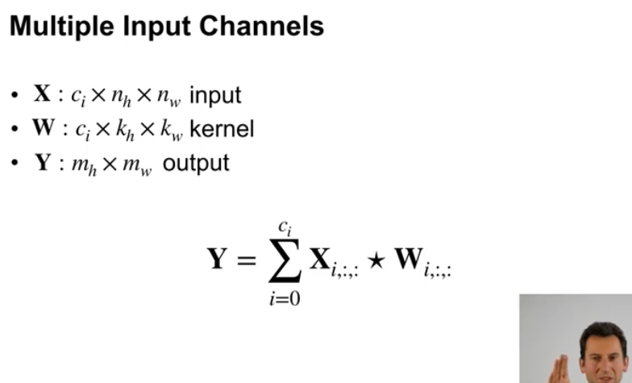
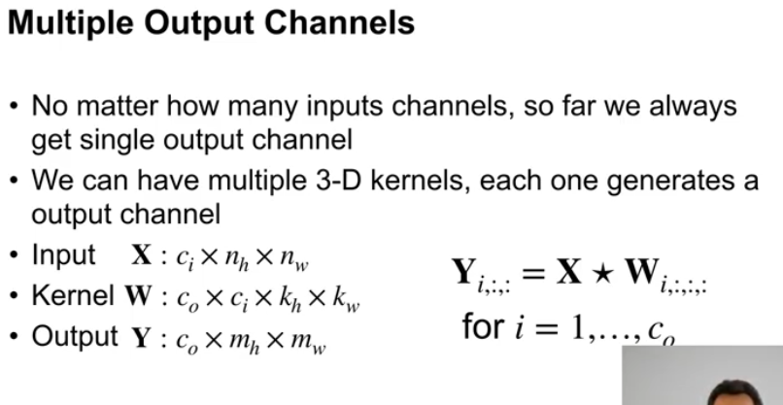
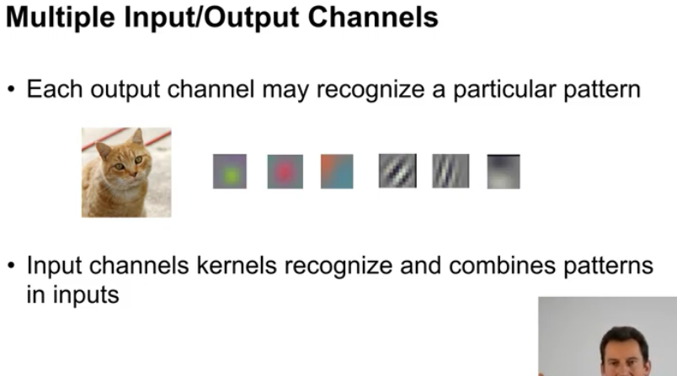
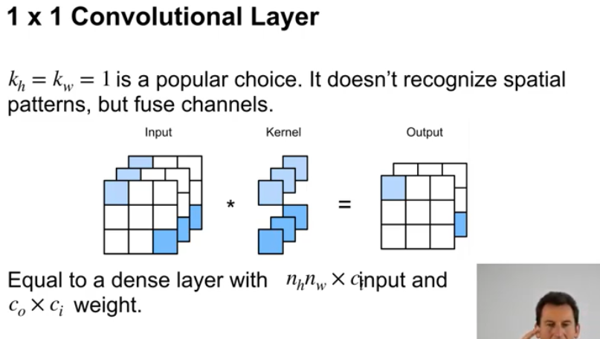

Slide 5
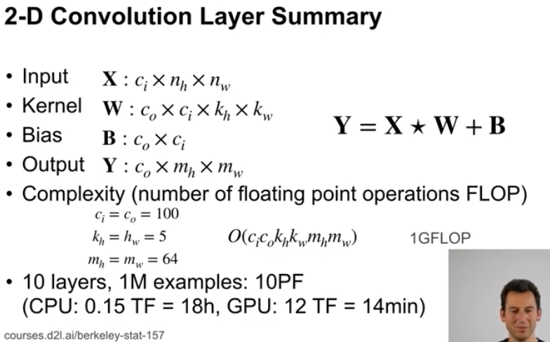
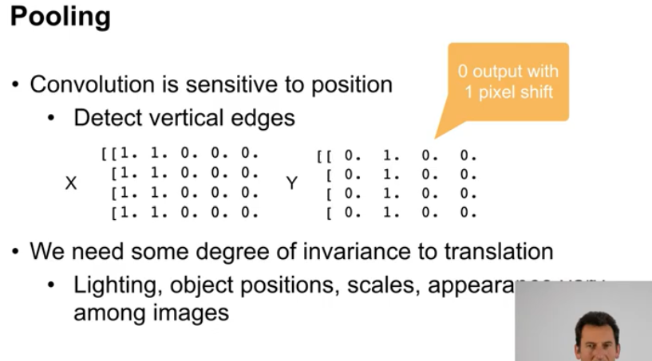
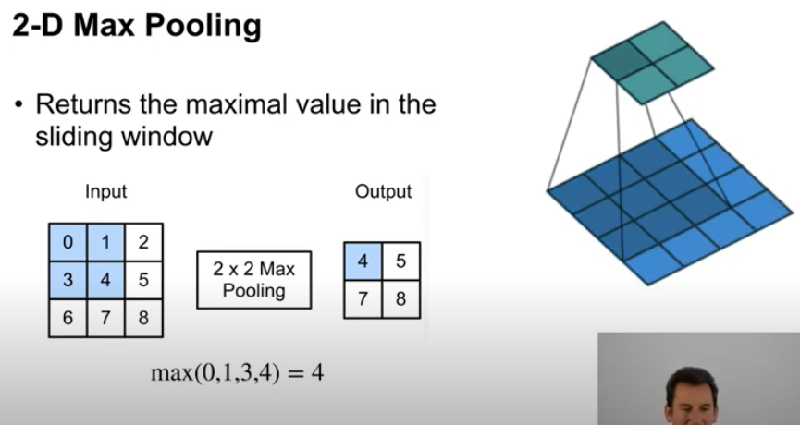
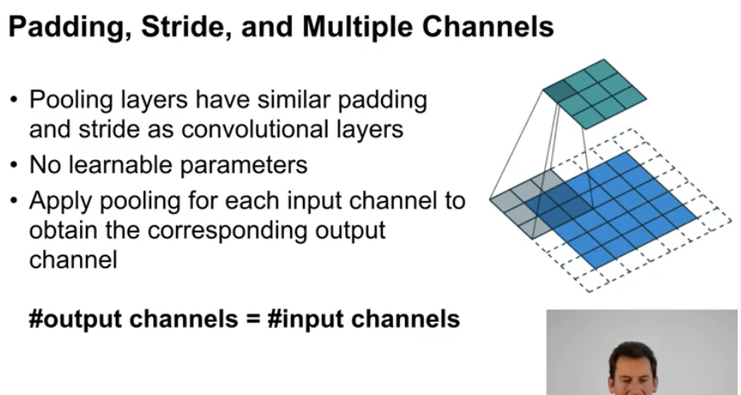

Slide 6
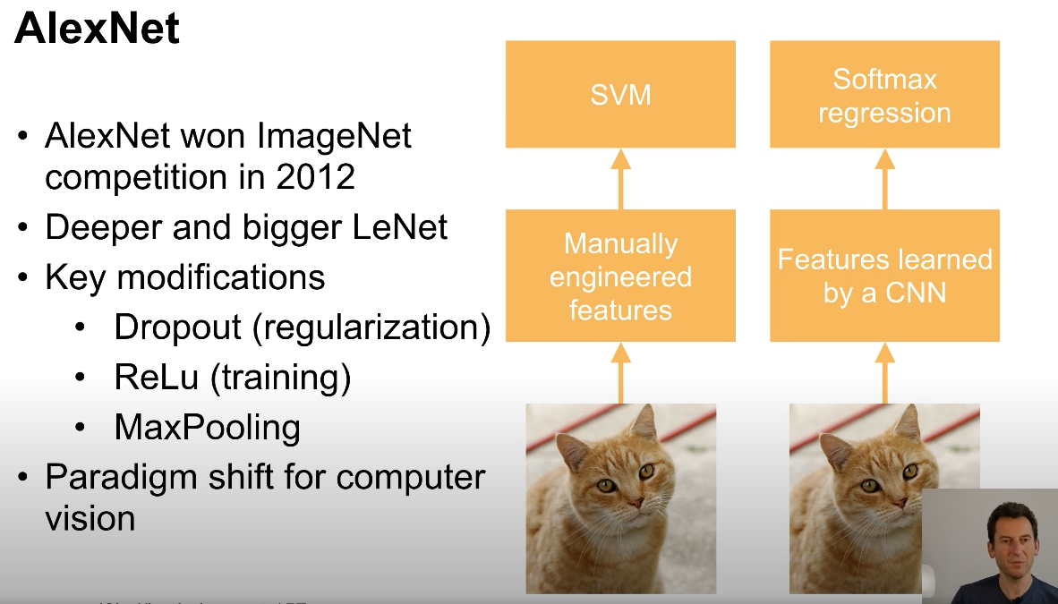
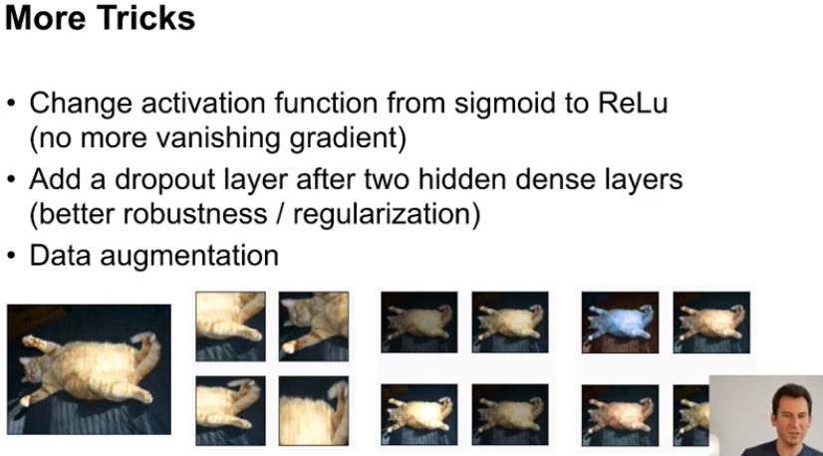
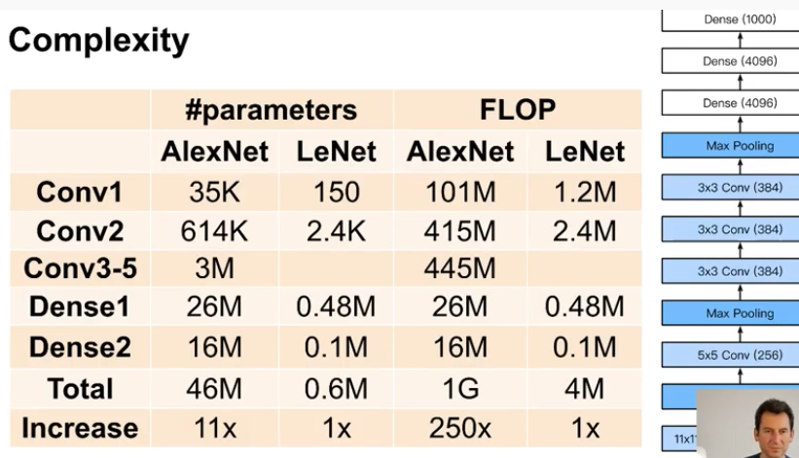
Features learned automatically instead of hand crafted, followed by a softmax
Dropout regularization : allowed to design deeper networks, regularize not just the input but also the inner structure of the network, regularization applied to all the layers of the network
ReLu : replace sigmoid non linearity by max with 0, so that the gradient would not longer vanish because you have at least on half space where the function is the identity
Max pooling : replace avg pooling, features more shift invariant, you can move your attributes a little bit and max pooling can still pull the relevant attributes through
Data augmentation : train on cropped parts instead of the original image, transformations on brightness / color space / …, to improve the robustness to changes you might have between training and test examples
Tradeoff between computation and memory changed a lot (250x compute vs 10x mem) : memory scales with the amount of silicon, compute with the amount of compute units

Slide 7
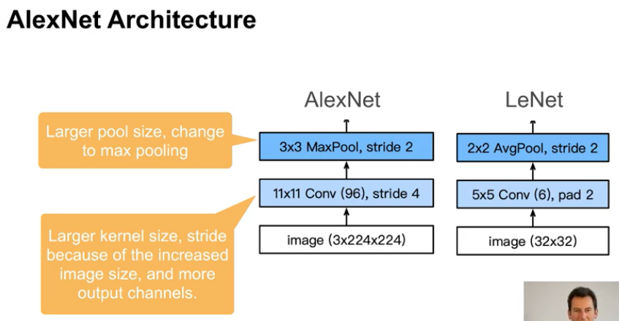
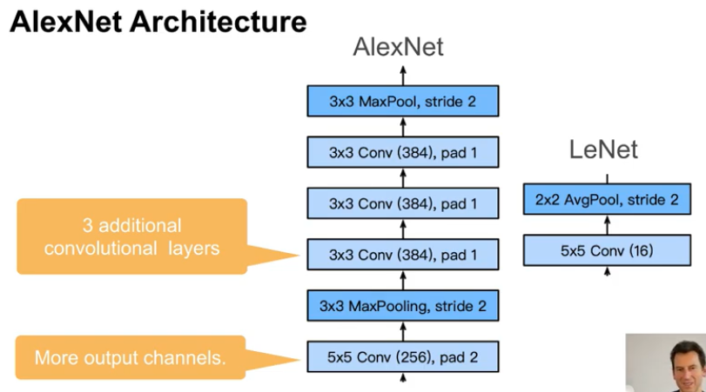
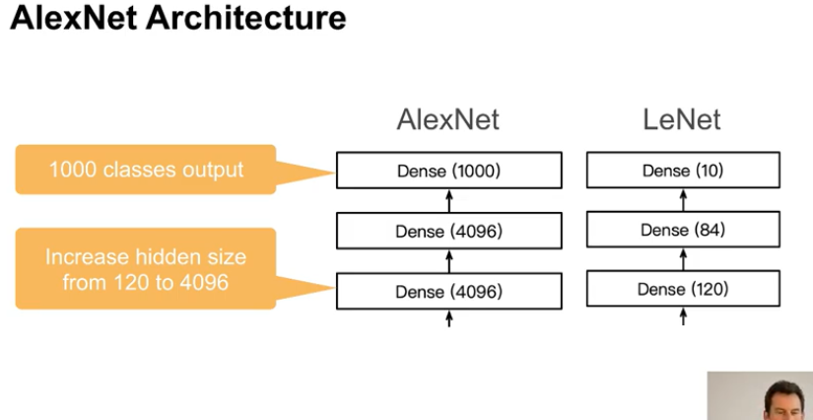
Intake : much larger image resolution, many more channels (96), max pool
Bulk : lot more channels (16x), lot more convolutions later on => much more expressive degreee of non linearity => allows to recognize a lot more classes
Classifier : 4096 hidden units instead of 120, necessary to have enough information for 1000 output classes (need more than 1000 features to describe 1000 classes, upper natural limit = size of the GPUs)

Slide 8
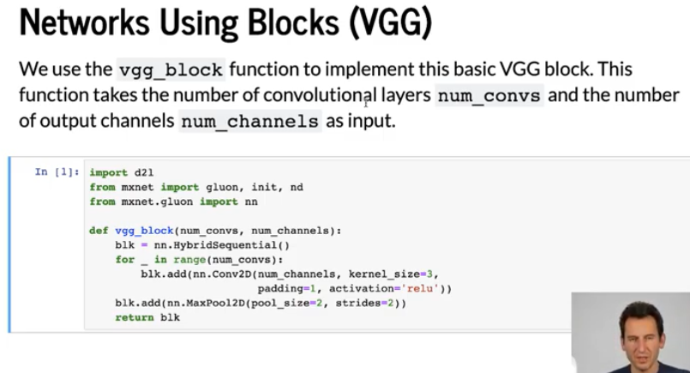
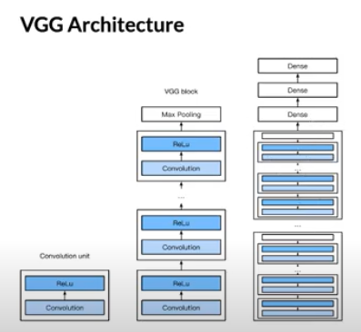
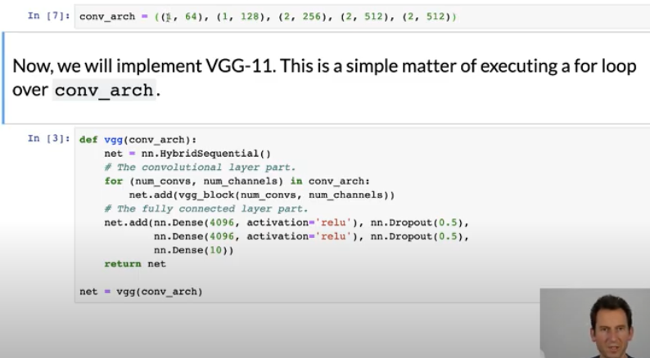
Design of networks : not in terms of individual layers, but designing blocks, and then composing the network out of blocks
Now the network looks very clean as a simple for loop configured by a list of parameters
VGG block : num_convs x 3x3 conv, then max pool stride=2
VGG network : blocks then 3 dense layers
VGG-11 : (1,64) (1,128) (2,256) (2,512), (2,512) => Dense(4096)

Slide 9
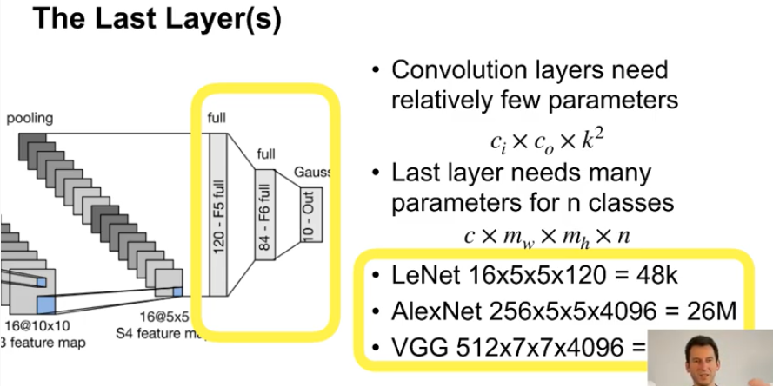
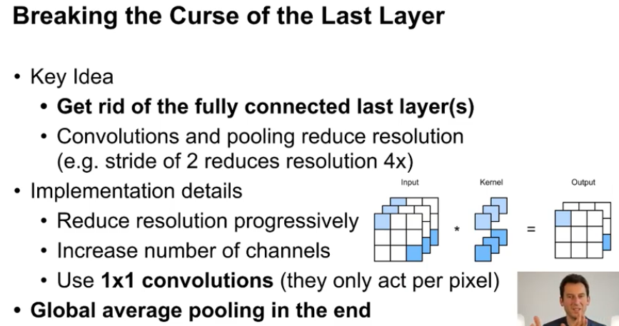
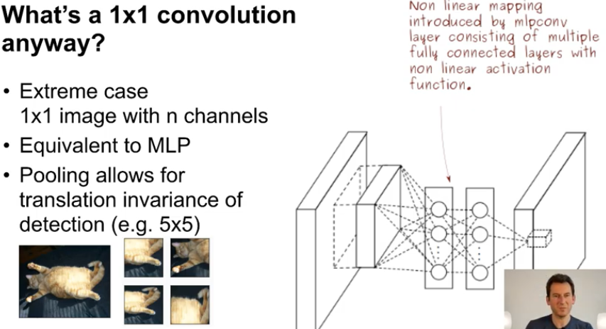
Problem : the last dense layers consume too much memory, ex VGG = 102 Million parameters in the first dense layer !!
Networks in networks : convenient strategy to make the networks smaller = multilayer perceptron inserted as intermediate layers in the convolutional network
The goal is to get rid of dense layers at the end of the network
Solution is to insert 2 layers 1x1 convolutions inside the network, equivalent to a 2 layers perceptron on the features pixel by pixel

Slide 10
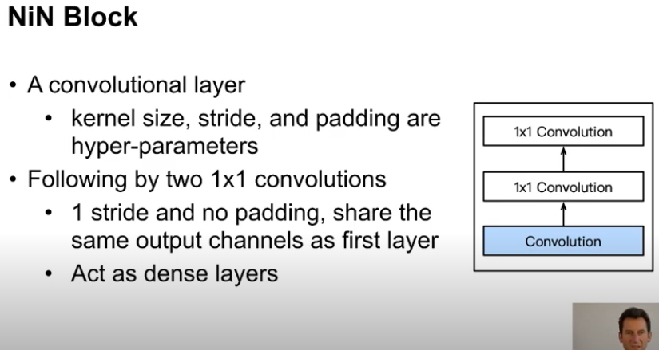
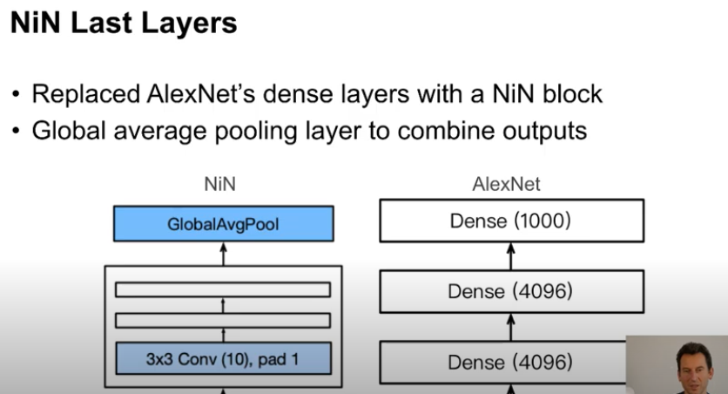
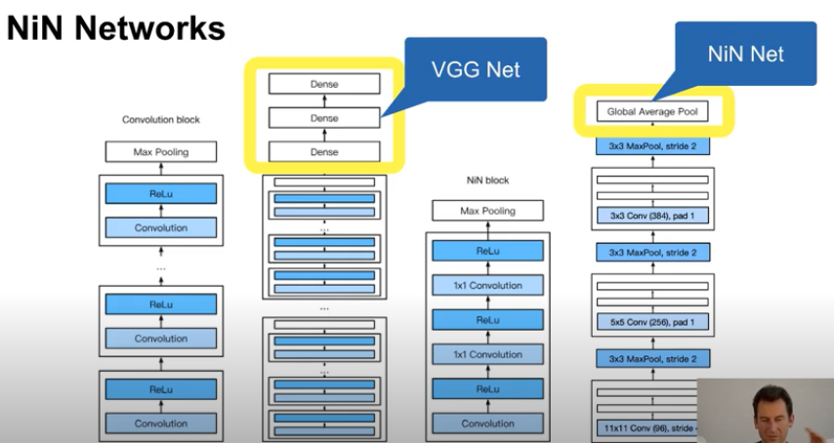
Replace dense layers with : use 2 layers of 1x1 convolutions each time just before you downsample the resolution of the image, then add global pooling at the end
Doesn’t work so well as is (66% vs 90%)

Slide 11
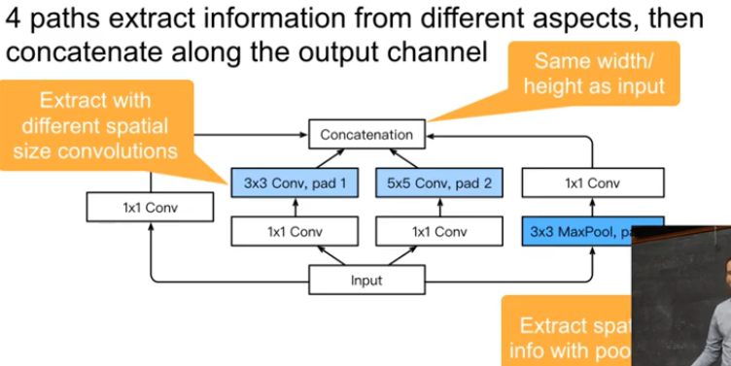
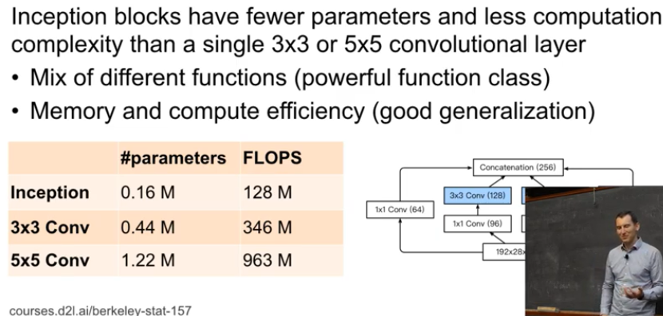
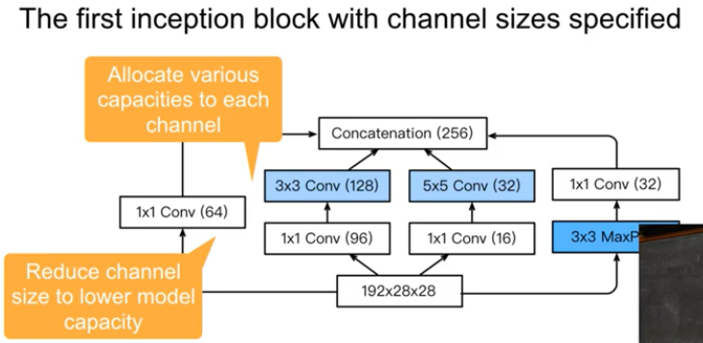
How to choose the size of convolutions ?
5x5 : lot of parameters (memory+, don’t generalize as well), lot of multiply-adds (compute+, slow), but very expressive
1x1 : much more efficient, but doesn’t work so well
GoogleNet / Inception (« we need to go deeper ») : why choose ? Just pick them all
Split the output channels, compute each group with a different conv path
In aggregate :
Less parameters and FLOPS than a simple 3x3 convolution (better generalization)
Homogenous compute : k2.ci.co.mh.mw
Heterogenous compute : ci.mh.mw.(SUMj kj2.cj)
Choose kj and cj so that SUMj cj = co (concat), and SUMj < k2.co (less compute)
Mix of different spatial functions = poweful : 5x5 could get longer range info than 3x3

Slide 12
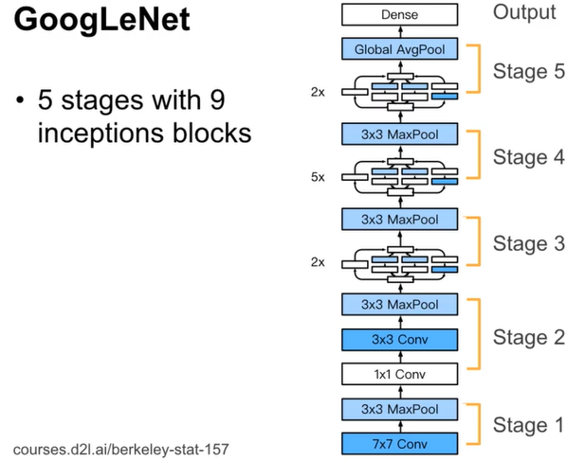
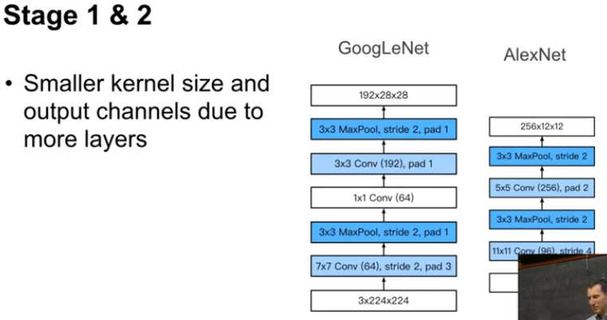
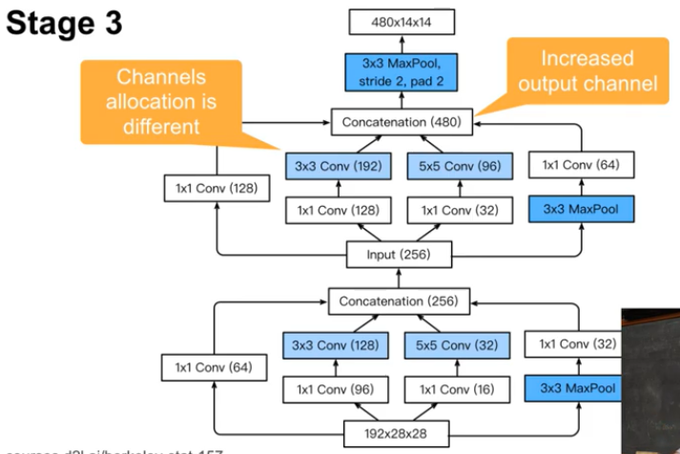
Each stage divides the resolution by 2 with max pooling, while increasing the number of channels (fewer pixels, more higher order information)
Stage 1 : 7x7 conv / 3x3 pool = start with broad convolution and pooling, basic amount of translation invariance, and reduce the resolution early
Stage 2 : get overall spatial correlation and then pooling operation
Stages 3-5 : 2x 5x 2x inception blocks, 5x is the backbone where most interesting non linearities happen

Slide 13
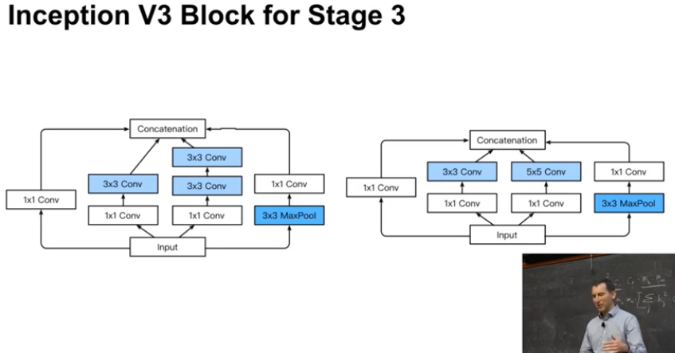
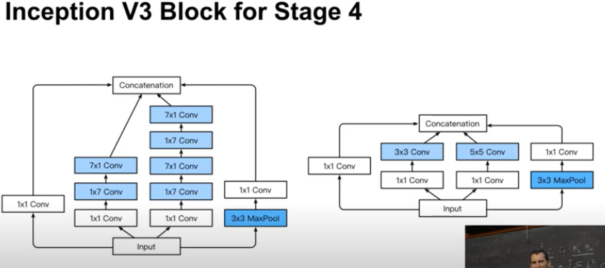
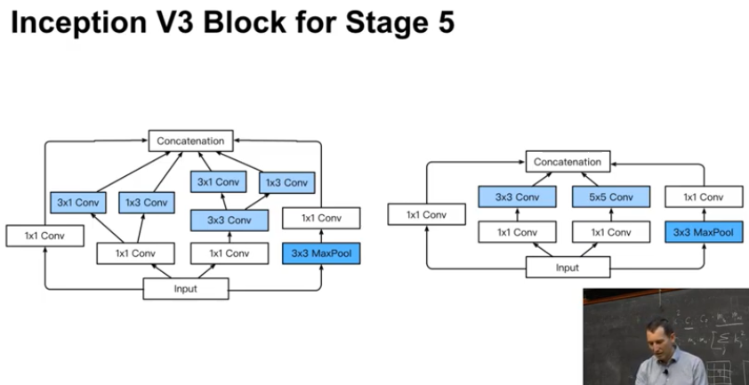
Improvements overall the architectural pattern
Add batch norm
More convolution sizes + deeper size
Add residual connections, but still doesn’t work as well as resnets
Replace 5x5 by two 3x3 : deep and narrow is better than wide and shallow
Replace 5x5 by two (1x7 then 7x1)
Asymetric convs, 25 params to 28, cost is similar but much more expressive
1x7 / 7x1 : add horizontal features to vertical features, one after the other
Replace 3x3 by (3x1 concat 1x3)

Slide 14
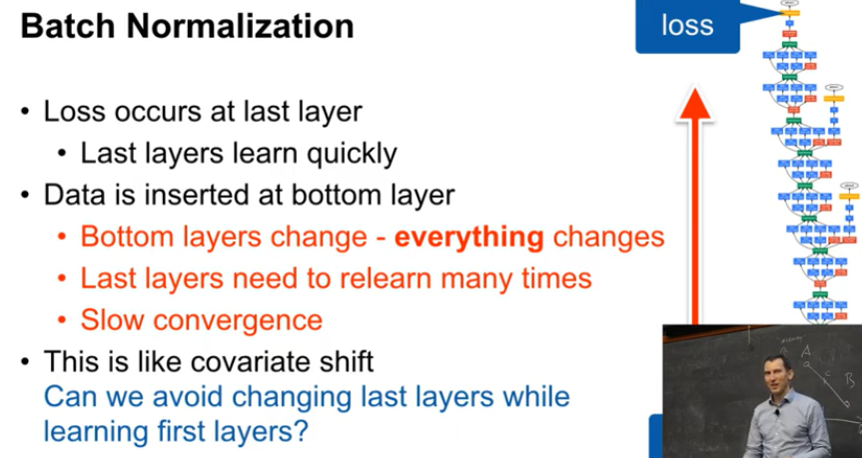
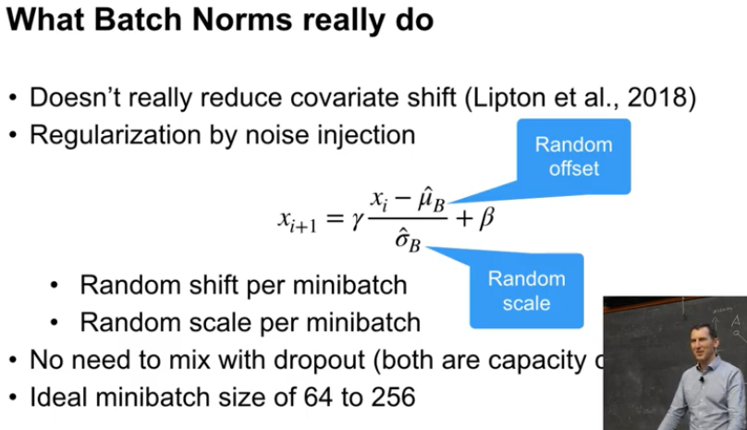
Initial intuition : reduce covariate shift – but proved to be wrong in 2018
Cascade of parameters adapting starting from the top and making progress to bottom
But then the features that come up from the data at the bottom are going to change
Now the last layer, wich was starting to be fairly well adapteds, has to readapt to the new inputs it is getting
So it takes a very long time for the training signal to lead to convergence
Can we avoid changing the last layers while learning the first layers ?
Fix mean and variance, and adjust it separately (per batch)
What it really does : Regularization by noise injection
Random shift and scale per minibatch (muB and sigmaB)
Noisy affine tranformation, good way to add noise calibrated to the size of the output
Things converge much more nicely, because you bring everything back to a reasonable well defined scale
Takes care of a lot of the capacity control, most sophisticated way of regularizing
Ideal minibatch size of 64 to 256 : too small = too much noise, too big = not enough noise
You don’t need dropout nearby, they do the same thing
Implementation
Gamma and beta learned scale and offset, fixed at test time
muB and sigmaB computed on a batch at training time, on a long running average at test time
For convolutions : one normalization per channel

Slide 15
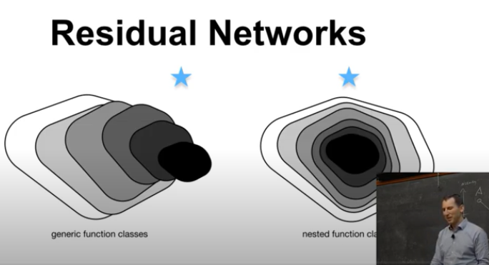
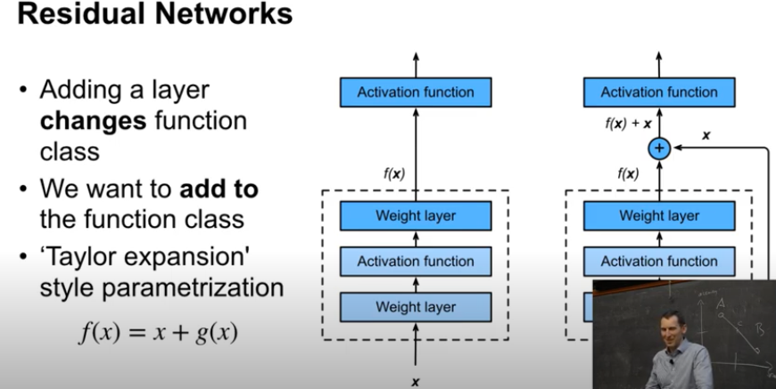
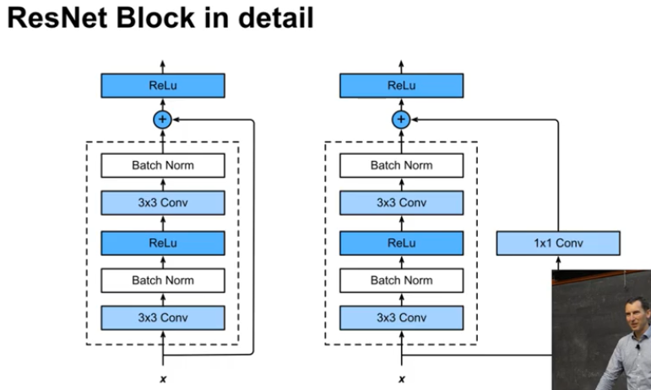
What residual networks do (intuition)
When I add layers, I want more powerful and NESTED class of functions
Solution : deviate from the identity function
Then I don’t have to learn the identity function anymore
Parametrization away from the identity function instead of from the zero function
ResNet block
3x3 > batch norm > ReLu > 3x3 > batch norm
People tried all permutations of conv / ReLu / batch norm
This is the order that works better
Then : two variants
add X
add 1x1 conv (X) [when downsampling with stride 2]

Slide 16
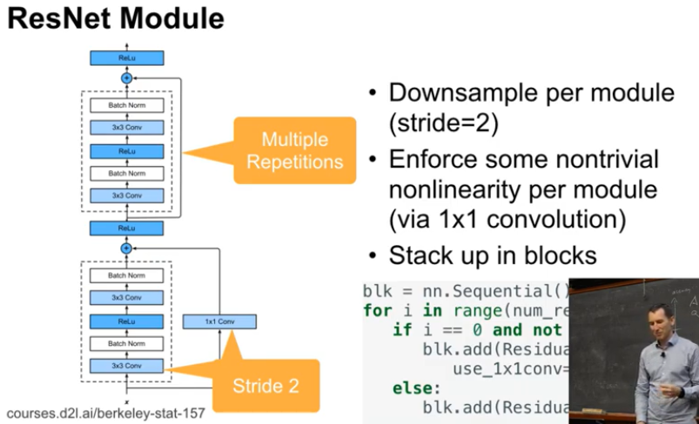



ResNet module
One resnet block with downsampling (stride 2)
Multiple repetitions of a resnet block with no downsampling
ResNet network
Wide convolution, batchnorm, pooling
Then ResNet modules
No downsample in the first module : you don’t want to downsample too aggressively at the beginning
Then global average pooling
ResNet 18 to ResNet 152

Slide 17



ResNext
Partitioning so that inter channels interactions only happen by groups of 4
Instead of one network of 64 channels, 16 networks of 4 channels stacked
If we break up the channels into b groups, we get a reduction of computation cost of 1/b (b groups times ci/b x co/b)
As a result we can use more dimensions
Just need to set group parameter to the 2D convolutions
ResNet and ResNext : computation budget is very close, but it works a little bit better
Note : special case of sparse matrix … but GPUs are awful with sparse matrices => we implement a block-sparse predefined strategy

Slide 18


DenseNet => IGNORE
Higher order Taylor style expansion
Xi+1 = [Xi, f(Xi)]
Warning : sometimes better results just with better training
In this case : ResNet and ResNeXt perform better if trained well
Squeeze-Excite Net
Idea 1 : learn a way to weight the channels depending on the input (features are more important in some cases)
Idea 2 : provide a way to enable information to travel across the image faster
Uses self attention : learns a function that gates how the average is computed, per layer, computed in parallel with the convolutions
Per channel : take inner product of the entire image with a vector
Use the results with a softmax over them to reweight the channels
Improves the accuracy, currently the best one in the model zoo

Slide 19


SuffleNet
ResNext breaks convolution into subgroups of channels : less computation, but less interactions between feature channels
Reshuffle things in between convolutions to avois pipes from the beginning to the end of the network (fixed, not learned)
Gives a little bit more accuracy
You can apply it to any network architecture
MobileNet with (depthwise-)Separable convolutions
Precursor of ResNext with groups of one channel

Slide 20


Scaling
Width : number of filters per layer => capture more fine grained features, richer compositions
Depth : more layers => capture more complex features, generalize well on new taksks
Resolution : input resolution => more fine grained patterns, for classes hard to distinguish
Scaling each dimension independently gets diminishing returns
If you scale all dimensions at the same time, accuracy gains compound for longer
Reason : if the input image is bigger, the network needs more layers to increase the receptive field, and more channels to capture more fine-grained patterns on the bigger image
EfficientNet :
a x layers = a x Flops / b x filters = b^2 x Flops / c x resolution = c^2 x Flops = a.b^2.c^2 x flops
Optimization goal : find max accuracy while multiplying Flops by 2
Building block : MNConv from MobileNet 2 with squeeze and excite optimization
Result : a=1.2, b=1.1, c=1.15 => raised to the power of 0 to 7 = EfficientNet B0 to B7

Slide 21


EfficientNet
EfficientNet B0 found by expensive neural architecture search
EfficientNet Bi => EfficientNet Bi+1 = 2xFlops
On average 5 times less parameters and around 10 times less Flops
Works on all datasets
… you don’t need any other model anymore …

Slide 22



EfficientNet
Stacking MBConv modules from MobileNet v2 paper
1x1 convolution : expand features to a much higher dimension
RelLU6 : we cap the units at 6, so our ReLU activation function is y = min(max(x, 0), 6). In our tests, this encourages the model to learn sparse features earlier
Depthwise separable convolution
1x1 convolution return the features dimension to the same size as the input
Needed for residual connection
Features creation seen as a 2 step process
1. Feature aggregation, group relevant features together
2. Spatially process each of these groups of features individually to create new features
Residual connection from start to finish
Layers had two tasks : find new features and carry forward features already found
Now all our convs are working on feature creation instead of carrying information ahead
Overcomplete auto-encoder
Reconstruct the raw features wich were aggregated in the previous stage
Inputs to MBConvs are compressed feature sets
MBConvs projecting them in a higher dimension space before creating new features

Slide 23



Deformable Convolutional Networks
Deformable Convolutional Networks | Papers With Code
Review: DCN / DCNv1 — Deformable Convolutional Networks, 2nd Runner Up in 2017 COCO Detection (Object Detection) | by Sik-Ho Tsang | Towards Data Science

Slide 24




Cross-Stage Partial Networks
CSPNet: A New Backbone that can Enhance Learning Capability of CNN | Papers With Code

Slide 25





Slide 26




For DETECTION and SEGMENTATION : 1 sample per GPU

Slide 27

ATSS: Bridging the Gap Between Anchor-based and Anchor-free Detection via Adaptive Training Sample Selection | Papers With Code
Today’s popular one-stage object detectors mainly have two kinds:
anchor-based
YOLOv3: An incremental improvement
RetinaNet: Focal loss for dense object detection
At present, the more accurate real-time onestage object detectors are anchor-based
EfficientDet : Scalable and efficient object detection
YOLOv4: Optimal speed and accuracy of object detection
PP-YOLO: An effective and efficient implementation of object detector
anchor-free
CenterNet: Keypoint triplets for object detection
CornerNet: Detecting objects as paired keypoints
CornerNet-Lite: Efficient keypoint based object detection
FCOS: Fully convolutional one-stage object detection
Among all anchor-free approaches, CenterNet [Objects as points. In arXiv preprint arXiv:1904.07850] is very popular because it does not require complicated post-processing, such as Non-Maximum Suppression (NMS).
Anchor-free detectors directly find objects without preset anchors in two different ways.
One way is to first locate several pre-defined or self-learned keypoints and then bound the spatial extent of objects. We call this type of anchor-free detectors as keypoint-based methods
Cornernet: Detecting objects as paired keypoints
Bottom-up object detection by grouping extreme and center points
Another way is to use the center point or region of objects to define positives and then predict the four distances from positives to the object boundary. We call this kind of anchor-free detectors as center-based methods
FCOS: fully convolutional one-stage object detection
Foveabox: Beyond anchor-based object detector

Slide 28

State of the Art object detectors
Anchor based detectors :
One stage : YOLOv2[31], YOLOv3[32], YOLOv4[1], RetinaNet [22], RefineDet [44], EfficentDet [35], FreeAnchor [45]
Two stages : faster R-CNN [33], FPN[21], Cascade R-CNN[2], Trident-Net[20]
Anchor-free detectors:
Anchor-point based detectors : FSAF [49], FCOS[36], FoveaBox[17], SAPD[48]
Keypoint based detectors : CornerNet[19], CenterNet[8], ExtremeNet[47] and RepPoint[40]
Among all anchor-free approaches, CenterNet [42] is very popular because it does not require complicated post-processing, such as Non-Maximum Suppression (NMS). At present, the more accurate real-time one stage object detectors are anchor-based EfficientDet [31],YOLOv4 [1], and PP-YOLO [19].
PP-YOLO : PP-YOLO: An Effective and Efficient Implementation of Object Detector (arxiv.org)
Scaled YOLO v4: Scaled-YOLOv4: Scaling Cross Stage Partial Network | Papers With Code
ATSS: Bridging the Gap Between Anchor-based and Anchor-free Detection via Adaptive Training Sample Selection | Papers With Code
PPDET : Reducing Label Noise in Anchor-Free Object Detection | Papers With Code
RepPoints : GitHub - microsoft/RepPoints: Represent Visual Objects by Point Sets

Slide 29


PP-YOLO
This paper introduces an improved YOLOv3 model : unlike YOLOV4, we have not explored some widely studied parts such as data augmentation and backbone. Many tricks we discussed in this paper are different from YOLOV4
We directly use the most common ResNet[13] as the backbone of PP-YOLO, for data augmentation, we directly used the most basic MixUp (various deep learning frameworks have deeply optimized for ResNet series, which will be more convenient in actual deployment and will have better inference speed in practice)
We replace some convolutional layers in ResNet50-vd with Deformable Convolutional Layers : in order to balance the efficiency and effectiveness, we only replace 3 × 3 convolution layers in the last stage with DCNs
Larger Batch Size Using a larger batch size can improve the stability of training and get better results. Here we change the training batch size from 64 to 192, and adjust the training schedule and learning rate accordingly
EMA When training a model, it is often beneficial to maintain moving averages of the trained parameters. We apply EMA with decay λ of 0.9998 and use the shadow parameter WEMA for evaluation.
DropBlock is a form of structured dropout, where units in a contiguous region of a feature map are dropped together. Different from the original paper, we only apply DropBlock to the FPN (triangles), since we find that adding DropBlock to the backbone will lead to a decrease of the performance.
IoU Loss We do not replace the L1-loss with IoU loss directly, we add another branch to calculate IoU loss. We find that the improvements of various IoU loss are similar, so we choose the most basic IoU loss.

Slide 30


PP-YOLO (suite)
IoU Aware An IoU prediction branch is added to measure the accuracy of localization. During training, IoU aware loss is adopt to training the IoU prediction branch. During inference, the predicted IoU is multiplied by the classification probability and objectiveness score to compute the final detection confidence, which is more correlated with the localization accuracy. The final detection confidence is then used as the input of the subsequent NMS.
Grid Sensitive When we decode the coordinate of the bounding box center x and y, we change the equation to : x = s · (gx + α · σ(px) − (α − 1)/2), where α is set to 1.05 in this paper. This makes it easier for the model to predict bounding box center exactly located on the grid boundary.
Matrix NMS Matrix NMS is motivated by Soft-NMS, which decays the other detection scores as amonotonic decreasing function of their overlaps. However, such process is sequential. Matrix NMS views this process from another perspective and implements it in a parallel manner.
CoordConv works by giving convolution access to its own input coordinates through the use of extra coordinate channels. CoordConv allows networks to learn either complete translation invariance or varying degrees of translation dependence. CoordConv will add two inputs channels to the convolution layer. In order to reduce the loss of efficiency, we only replace the 1x1 convolution layer in FPN and the first convolution layer in detection head with CoordConv (diamonds).
Spatial Pyramid Pooling SPP integrates SPM into CNN and use max-pooling operation instead of bag-of-word operation. YOLOv4 applies SPP module by concatenating max-pooling outputs with kernel size k × k, where k ={1, 5, 9, 13}, and stride equals to 1. Under this design, a relatively large k × k max-pooling effectively increase the receptive field of backbone feature. In detail, the SPP is only applied on the top feature map as shown in Figure 2 with ”star” mark.
Better Pretrained Model Using a pretrain model with higher classification accuracy on ImageNet may result in better detection performance. Here we use the distilled ResNet50-vd model as the pretrain model [29] .

Slide 31

Scaled Yolo v4
First, we re-design YOLOv4 and propose YOLOv4-CSP, and then based on YOLOv4-CSP we developed scaled-YOLOv4

Slide 32
Specific OCR requirements
Très grand nombre d’objets
Peu de recouvrements
Tous les objets alignés horizontalement par paquets
Seul l’ordre des lettres compte, les bounding boxes précises au pixel près ne nous intéressent pas
Considérer une grille qui divise la résolution par 4 : on ne détecte pas les caractères de moins de 4 pixels de large
Tout se lit de gauche à droite : prédire si chaque pixel est le début d’un mot (suit un espace), prédire si chaque pixel est le début d’une lettre
Tout se lit de haut en bas : prédire si chaque pixel est la base d’une ligne
Identifier les images et les lignes horizontales / verticales comme une classe de caractères

Slide 33
Annexes
YOLO v4 : Explanation of YOLO V4 a one stage detector | by Pierrick RUGERY | Becoming Human: Artificial Intelligence Magazine
Scaled YOLO v4 : WongKinYiu/ScaledYOLOv4 (github.com)
Anchor free detection : Anchor Free Object Detection | Qiang Zhang (zhangtemplar.github.io)
ViT : https://paperswithcode.com/paper/an-image-is-worth-16x16-words-transformers-1
Cross-Stage Partial Networks :
HRNet
Perspective transformation – OpenCV 3.4 with python 3 Tutorial 13 - Pysource
https://paperswithcode.com/paper/fixing-the-train-test-resolution-discrepancy-2
https://paperswithcode.com/paper/self-training-with-noisy-student-improves
https://paperswithcode.com/paper/large-scale-learning-of-general-visual

Slide 34
Floating point format :
Even with 32 bits you can get numerical instabilities and overflows
More bits for Exponent = covers larger dynamic range, takes care of overflows better, otherwise you need to be more careful
More bits for Mantissa = accuracy within that range
BP16 : more bits for the exponent, less the mantissa than FP16

